Slide 1
Section 11.3
The Ellipse
Copyright © 2012 Pearson Education, Inc. Publishing as Prentice Hall.

Slide 2
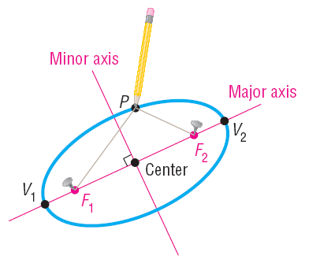
Copyright © 2012 Pearson Education, Inc. Publishing as Prentice Hall.

Slide 3
Copyright © 2012 Pearson Education, Inc. Publishing as Prentice Hall.

Slide 4

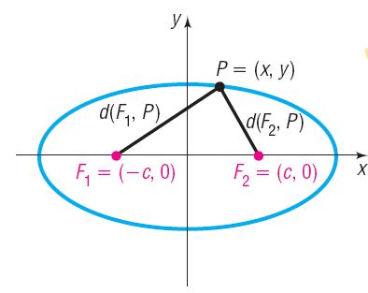
Copyright © 2012 Pearson Education, Inc. Publishing as Prentice Hall.

Slide 5
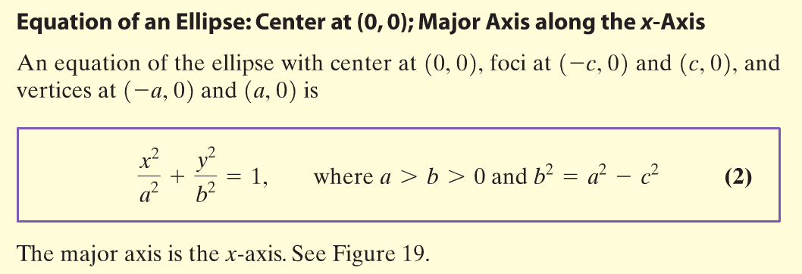
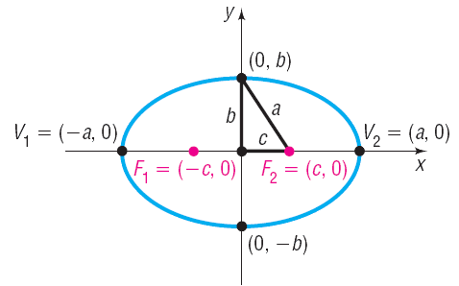
Copyright © 2012 Pearson Education, Inc. Publishing as Prentice Hall.

Slide 6


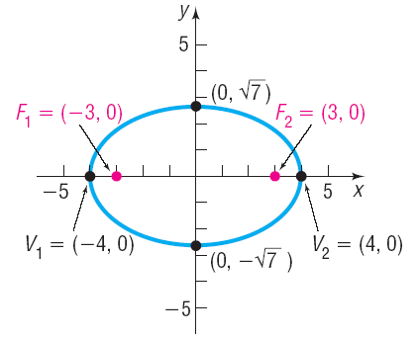



Find an equation of the ellipse with center at the origin, one focus at (3, 0) and a vertex at (– 4, 0). Graph the equation.
From the center to one vertex is a = 4. From the center to one focus is c = 3.
Copyright © 2012 Pearson Education, Inc. Publishing as Prentice Hall.

Slide 7

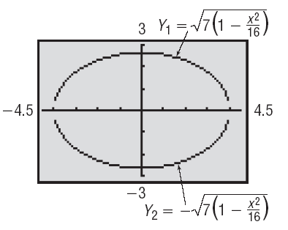
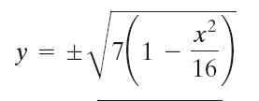
Copyright © 2012 Pearson Education, Inc. Publishing as Prentice Hall.

Slide 8
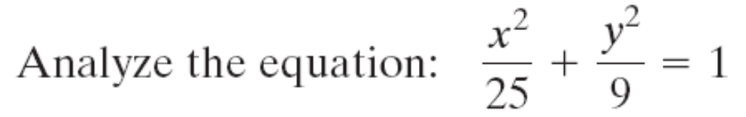
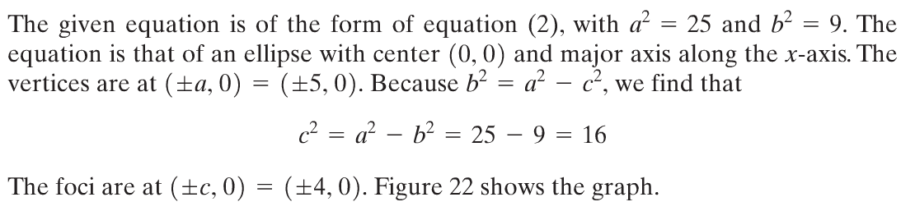
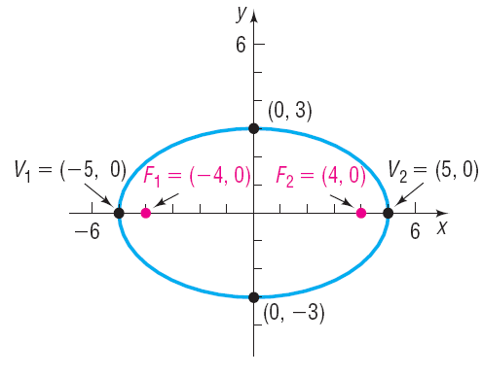

Copyright © 2012 Pearson Education, Inc. Publishing as Prentice Hall.

Slide 9
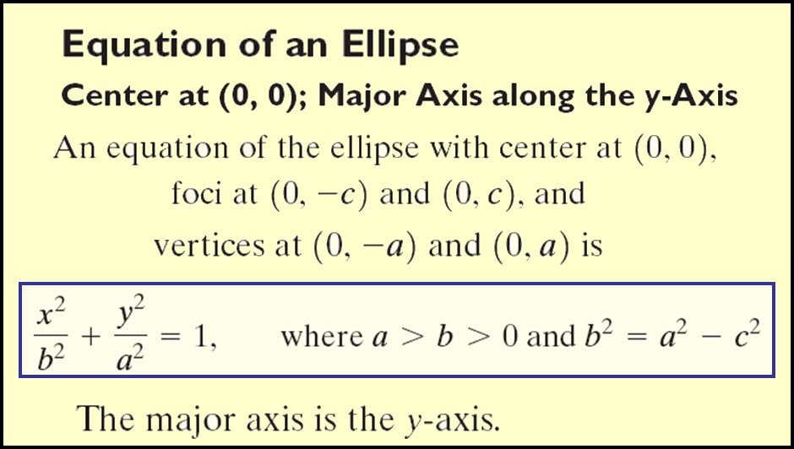
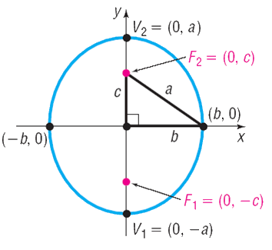
Copyright © 2012 Pearson Education, Inc. Publishing as Prentice Hall.

Slide 10

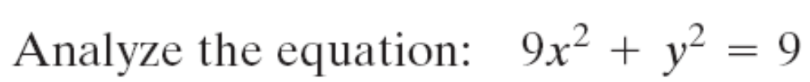
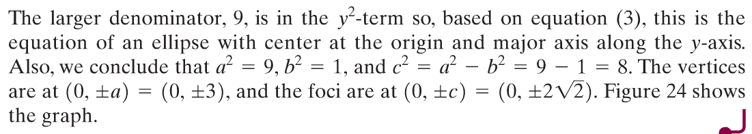
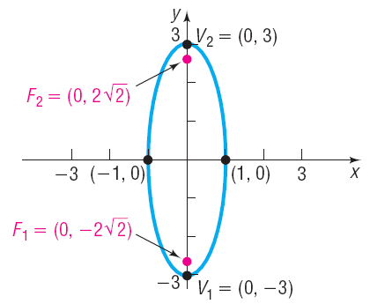
Copyright © 2012 Pearson Education, Inc. Publishing as Prentice Hall.

Slide 11

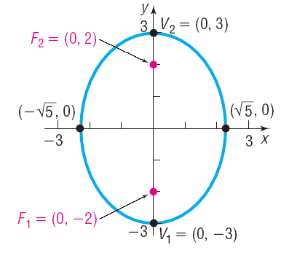



Find an equation of the ellipse having one focus at (0, 2) and vertices at (0, –3) and (0, 3). Graph the equation by hand.
The distance from the center to a focus is c = 2
The distance from the center to a vertex is a = 3
Copyright © 2012 Pearson Education, Inc. Publishing as Prentice Hall.

Slide 12
Copyright © 2012 Pearson Education, Inc. Publishing as Prentice Hall.

Slide 13
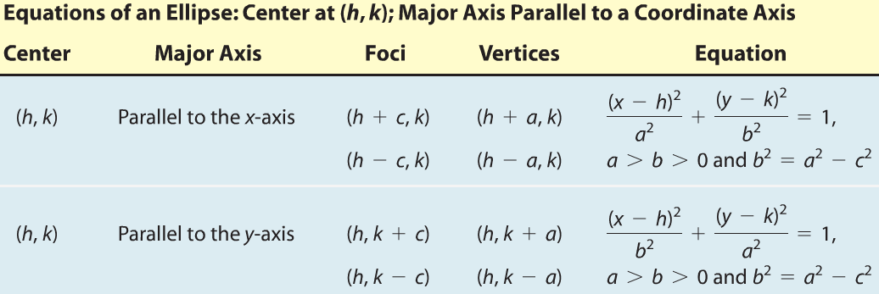
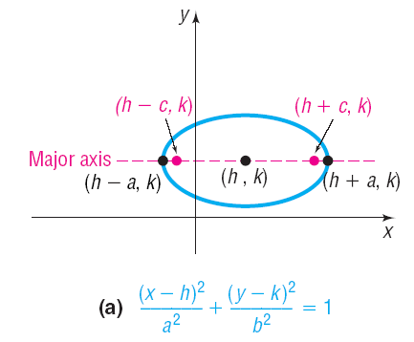
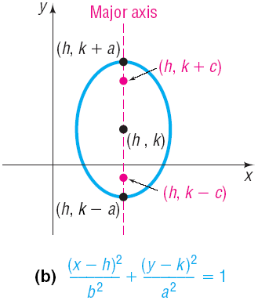
Copyright © 2012 Pearson Education, Inc. Publishing as Prentice Hall.

Slide 14



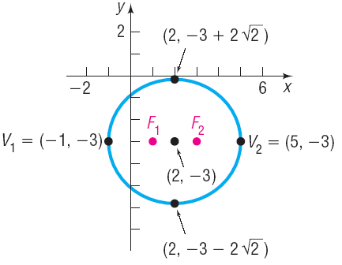

Find an equation for the ellipse with center at (2, –3), one focus at (3, –3), and one vertex at (5, –3). Graph the equation by hand.
Center and vertices lie on line y = – 3 so major axis is parallel to x-axis.
The distance from the center to a focus is c = 1;The distance from the center to a vertex is a = 3
Copyright © 2012 Pearson Education, Inc. Publishing as Prentice Hall.

Slide 15




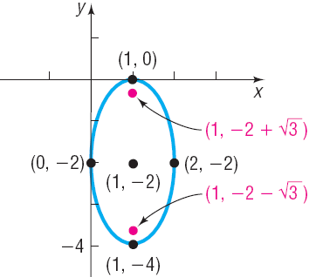

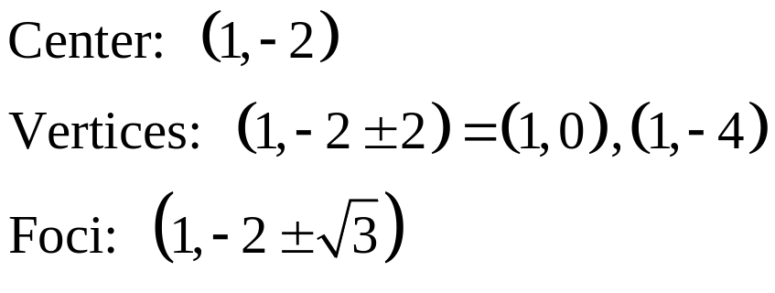
Copyright © 2012 Pearson Education, Inc. Publishing as Prentice Hall.

Slide 16
Copyright © 2012 Pearson Education, Inc. Publishing as Prentice Hall.

Slide 17
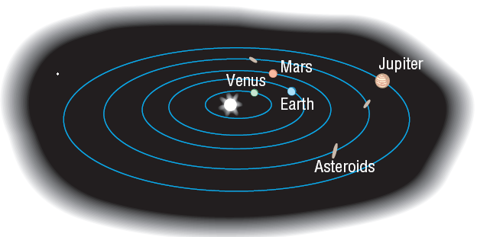
Copyright © 2012 Pearson Education, Inc. Publishing as Prentice Hall.

Slide 18





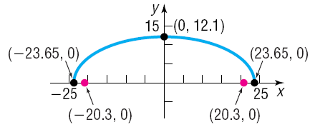

The whispering gallery in the Museum of Science and Industry in Chicago is 47.3 feet long. The distance from the center of the room to the foci is 20.3 feet. Find an equation that describes the shape of the room. How high is the room at its center?
Copyright © 2012 Pearson Education, Inc. Publishing as Prentice Hall.

